Slide 2
Connecting the Dots, HOME-ARP Development and Services

Slide 3
Why is HOME-ARP so unique?
Unlike the existing HOME or development programs, where household eligibility is primarily income-based, and services are not provided, or homeless service programs that may have limited access to affordable housing, HOME-ARP focuses on producing housing and providing services for specific groups, known as Qualifying Populations (or QPs), who commonly face housing instability with a goal to work towards self sustainability.

Slide 4
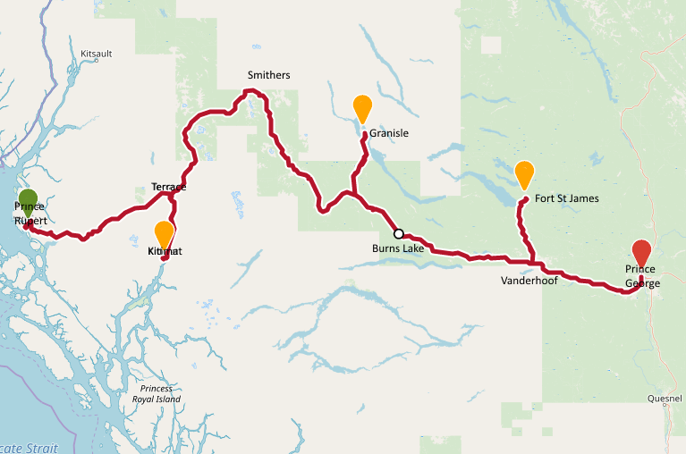
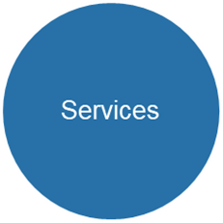
Affordable Housing Development
This Photo by Unknown Author is licensed under CC BY-SA

Slide 5
QP
Services
Nonprofits
Linking affordable and sustainable
Affordable Housing Development

Slide 6
Program Silos
No more working in silos, the HOME-ARP program forces the service and development programs that target the same low-income populations to work together to improve outcomes.
Affordable Rental Development, no Services or assistance
Homeless/risk services but no access
to Affordable Rental Units

Slide 7
HOME ARP Program Overview

Slide 8
QP: Eligible Population
Homeless
At Risk of Homelessness (30% AMI)
Fleeing/Attempting to Flee Domestic Violence, Dating Violence, Sexual Assault, Stalking, or Human Trafficking
Definitions from VAWA regulation at 24 CFR 5.2003, except
Human trafficking definition from Trafficking Victims Protection Act of 2000
Other Populations
Serve those with the Greatest Risk of Housing Instability
Serve those currently in short-term housing assistance programs and were homeless before receiving assistance.
Those was a housing burden (50% AMI)

Slide 9
HOME-ARP Activities
NCS (development)
Supportive Services
Tenant Base Rental Assistance
Rental Development

Slide 10
Non-Congregate Shelter
Eligible Activity
Ineligible Cost
Acquisition
Demolition
Rehab
Construction of NCS units
Development hard cost
Related Soft Cost
Operating cost
Cost to convert to rental housing

Slide 11
Supportive Services
Eligible Supportive Services: There are three categories specifically included as supportive services under HOME-ARP:
McKinney-Vento Supportive Services:
McKinney-Vento Supportive Services under HOMEARP are adapted from the services listed in section 401(29) of the McKinney-Vento Homeless Assistance Act (“McKinney-Vento Supportive Services”) (42 U.S.C. 11360(29)).
Homelessness Prevention Services, (Housing Relocation and Stabilization):
HOME-ARP Homelessness Prevention Services are adapted from certain eligible homelessness prevention services under the Emergency Services Grant (ESG) regulations at 24 CFR Part 576.
Housing Counseling Services:
Housing counseling services under HOME-ARP are those consistent with the definition of housing counseling and housing counseling services defined at 24 CFR 5.100 and 5.111, respectively, except that homeowner assistance and related services are not eligible HOME-ARP activities.

Slide 12
Rental Development
Eligible Activity
Eligible Cost
Acquisition
Construction
Rehabilitation
Reconstruction as defined in 24 CFR 92.2
Development hard cost
Acquisition cost
Related soft cost
Relocation cost
Operating Cost
Other

Slide 13
Rental Development Rental Project Requirements
Targeting and Occupancy
Not less than 70% of rental units must be restricted for QP that qualified at initial occupancy
Not more than 30% of rental units assisted with HOME-ARP funds may be restricted for occupancy by low-income households.
Proportions in individual projects may vary, but LI units are only allowed in projects that also have QP units restricted for qualifying households
Units Restricted for Occupancy by QP
Rent may not exceed 30% of the adjusted income of a household annual income whose income is at or below 50% AMI.
Rents cannot exceed Low HOME Rent limits
Gross rent= Rent + Utility Allowance

Slide 14
Tenant Based Rental Assistance (TBRA)
Eligible Activity
Project Requirements
Rental security deposits
Utility deposits
Rental assistance up to 100% of the rent based on household income.
Project-Based Subsidy
Portability of rental assistance
Rent reasonableness
Housing Quality Standards (NSPIRE)

Slide 15
Program Differences and Similarities

Slide 16
HOME-ARP QP vs Applicants for other Homeless Programs

Slide 17
Differences between QPs, CoC, ESG Applicants
HOME-ARP
Homeless: category 1, 2, 3
CoC/ESG
Homeless: 24CFR576/578 category 1, 2
Comparison
Homeless category 1 & 2 there are no differences
At risk of homelessness 30%AMI
ESG At risk of homelessness 30% AMI
Domestic violence
Homeless category 4, domestic violence
DV under HOME-ARP does not require that individuals “have no other resources”
Other: At risk at 50% AMI, or have previously been homeless and are in a temporary assistance program and need services do avoided homelessness
There is no differences
No equivalent
Households in Other may be currently receiving other CoC/ESG assistance

Slide 18
Differences between HOME-ARP, CoC, ESG Housing and Services
HOME-ARP
ESG/CoC
Rapid Rehousing
Street Outreach
Emergency Shelter
Transitional Housing
Permanent Supportive Housing
Homeless Prevention
NCS
Outreach
Supportive services
TBRA
Rental Development
No direct way to increase the housing stock except through partnership with HOME & LITC

Slide 19
Connecting the Dots
Development
Services
Project Sustainability

Slide 20
Beyond HOME-ARP
Plans should include project life beyond HOME-ARP:
Services
Rental subsidy

Slide 21
Rental Development and Supportive Services, TBRA

Slide 22
HOME-ARP Rental Development Challenges
Targeted low-income or homeless but may not be able to locate appropriate tenants.
Concerns about occupancy due to income.
Lack of resources to homeless/low-income tenants that reside on your property and may need support.
Limited or lack of transportation

Slide 23
HOME-ARP Rental Development Challenges
Challenge: Most HOME-ARP qualifying households are unable to pay sufficient rent to cover debt service & other operating costs
Project-based rental assistance (PBRA)/Master Leasing is an option
Other techniques to ensure sustainable HOME-ARP projects include
Mixed-income developments where market-rate or higher income restricted units subsidize HOME-ARP unit operating costs
LIHTC
HOME-ARP flexibility layering addresses challenges and creates sustainable projects

Slide 24
Rental Development with Services
Targeted low-income or homeless but may not be able to locate appropriate tenants.
Connected to agencies that will vet and refer QP to your property.
Concerns about occupancy due to income.
TBRA can provide rental assistance through:
TBRA portable vouchers
Master leasing/PBRA
Lack of resources to homeless/low-income tenants that reside on your property and may need support.
Supportive services can provide case management, life skills and other support.
Limited or lack of transportation
Transportation is eligible through HOME-ARP

Slide 25
HOME-ARP Rental Development and Master Leasing
Master Leasing and Use of a HOME-ARP Sponsor:
A HOME-ARP sponsor – a nonprofit organization that provides housing or supportive services to qualifying households – may execute a lease for a HOME-ARP unit or a master lease for multiple units in a project. The HOME-ARP sponsor may then sublease the HOME-ARP rental unit to a qualifying household.

Slide 26
Master Leasing and Rental Development
A master lease is a type of lease that gives the lessee the right to control and sublease the property during the lease, while the owner retains the legal title.
The lease will be between the supportive service agency and the property owner
The supportive service agency will then have a lease with the QP
Benefits:
It provides more protection for the QP and the property owner
It can help with subsidy layering and underwriting due to guaranteed assistance.
It can increase access to affordable units because it secures a block of units through a lease with the nonprofit agency

Slide 27
TBRA and Rental Development
Tenant Based Rental Assistance (TBRA) can be used on units developed through HOME ARP to subsidized the rent.
TBRA is not a stationary voucher but is portable and can move with the QP.
TBRA leases are between property owners and QP.

Slide 28
Rental Development Beyond HOME-ARP

Slide 29
Rental Development Beyond HOME-ARP
Rental development projects must serve the QP in accordance with the minimum use period which will extend longer than the HOME-ARP service time.
Minimum Compliance Period is 15 years
HOME-ARP subsidy and services will end September 30, 2030.

Slide 30
Rental Development Beyond HOME-ARP
The goal of HOME-ARP Supportive Services is to get QP to self-sustainability
Household income is sustainable and substantial
Rent is less than 30% of income
Household income is above 30%, 50%, 80% AMI
Household that met eligibility at move-in will keep their eligibility for ARP even if income increased above the eligibility limits.

Slide 31
Rental Development Beyond HOME-ARP
Housing Authority, Section 8 CHOICE Vouchers
Sign up for HA Section 8 at move-in if service plan determined that it was needed
Layer your development with HA resources
HOPWA TBRA/Master Leasing
Permeant Supportive Housing Voucher through the CoC
Short-Term Rental Assistance Programs
ESG- Rapid Rehousing and Homeless Prevention
SSVF
CoC Rapid Rehousing

Slide 32
Defining the relationship: Sponsor and Rental Property Developer
A HOME-ARP TBRA “sponsor” is a nonprofit organization that provides housing or supportive services to qualifying households and may:
Facilitate the leasing of a HOME-ARP rental unit or the use and maintenance of HOME-ARP TBRA.
Lease or master lease units from property owners and then sublease those units to HOME-ARP TBRA households.
Make rental subsidy and security deposit payments on behalf of HOME-ARP TBRA households.
Provide supportive services to HOME-ARP TBRA household.

Slide 33
Defining the relationship: Sponsor and Rental Property Developer
A HOME-ARP sponsor cannot also be the owner of the housing leased by a HOME-ARP TBRA household.

Slide 34
Non-Congregate Shelter and HOME-ARP

Slide 35
Non-Congregate Shelter
For purposes of HOME-ARP, NCS is defined as one or more buildings that:
Provide private units or rooms for temporary shelter
Serve individuals and families that meet one or more of the qualifying populations
Do not require occupants to sign a lease or occupancy agreement

Slide 36
NCS Admission and Occupancy
NCS occupants must:
Not be charged occupancy fees or other charges to occupy a HOME-ARP NCS unit unless the MHC PJ determines such fees and charges to be customary and reasonable and the charges comply with 24 CFR 578.77(b).
Meet the criteria for one of the four QP’s.

Slide 37
NCS Options Following Minimum Use Period
Remain as HOME-ARP NCS as originally developed.
Be used as NCS under ESG.
Be converted to permanent affordable housing.
Be converted to CoC permanent housing.

Slide 38
NCS with no changes
Remain an NCS
No change in use during the Restricted Use Period
Continued operation as originally specified in written agreement
Serve the same population

Slide 39
Non-Congregate Shelter Beyond HOME-ARP

Slide 40
Use as ESG NCS
ESG funds can be provided for operating and essential services
Operated in compliance with all requirements at 24 CFR part 576
All applicable ESG requirements govern in the event of conflict with HOME-ARP

Slide 41
NCS Conversion to Housing
HOME-ARP NCS units can be converted into permanent housing under the CoC program or permanent affordable housing after the restricted use period.

Slide 42
NCS Conversion to Housing
NCS projects proposal must indicate whether there is an intention to convert the NCS to affordable housing or CoC PSH following the minimum use period.
Project Type | Minimum Use Period
Acquisition Only | 3 Years
Moderate Rehab | 5 Years if total Investment <75% Appraised Value
Substantial Rehab | 10 Years if total Investment is >75% Appraised Value
New Construction | 10 Years

Slide 43
NCS and CoC Permanent Housing
NCS can be converted to CoC permanent housing (including permanent supportive housing) to serve the following eligible households as defined in 24 CFR 578.3:
Chronically homeless individuals
Homeless individuals or families
No HOME-ARP funds may be used for conversion a HOME-ARP NCS.

Slide 44
NCS: CoC PSH and Affordable Housed
Conversion to Permanent Affordable Housing | Conversion to CoC Permanent Housing
NCS is converted to permanent affordable housing according to the requirements established in Section VI.E. 11 of the Notice | NCS is converted to permanent housing as defined in Subtitle C of title IV of the McKinney-Vento Homeless Assistance Act (42 USC 11381 et seq.) according to requirements of this Notice and 24 CFR part 578.
Conversion only after a minimum use period as NCS | Conversion only after a minimum use period as NCS
May serve different population from original | Must serve eligible CoC populations

Slide 45
NCS Conversion to Affordable Housing
Agencies are encouraged to:
Pursue partnership and leveraging opportunities with the CoC early in the planning stage of a HOME-ARP NCS project.
Provide ARP supportive services or TBRA to qualifying households who must move as a result of conversion.

Slide 46
Rental Development & Supportive Services

Slide 47
Supportive Services
Eligible Activity
Ineligible Cost
Financial assistance
Rent application fees
Security deposits
Utility deposits
Rental arrears
Rent up to 6 months
Employment services, job training
Education services
Life skills
Food cost
Transportation
Child care
Legal services
Case Management
Outreach
Development/construction
Duplication of services
Rental assistance beyond 6 months
Operation cost for rental development or shelter

Slide 48
Outreach
Cost related to activities to engage, reach, and asses eligible applicants.
Homeless Outreach
Eligible cost include:
Outreach worker
Equipment for outreach worker
Essential supplies
Connection to mainstream programs
Outreach will ensure that property vacancies are quickly filled.

Slide 49
Case management
The cost of assessing and delivering the services needed to increase self-sustainability are eligible.
Case management can serve as a Liasson between QP and landlords, and between QP and essential resources
Developing a service plan and sustainable goals
Monitoring the progress towards set goals
Accessing financial resources

Slide 50
Employment and Job Training:
The costs of establishing and/or operating employment assistance and job training programs are eligible, including:
Providing a reasonable stipend
Learning skills including skills to retain a job, acquire a vocational licenses, certifications
Employment screening
Special training
Instruction materials
Referrals to other resources

Slide 51
Transportation
Access to reliable transportation is a critical element in QP self-sustainability
Eligible through HOME-ARP, but it will be needed beyond the HOME-ARP period of 9/30/2030
Plans should include project life beyond HOME-ARP:
Services
Transportation
Rental subsidy

Slide 52
Test Your knowledge

Slide 53
A community with unsheltered homeless identified a need for Non-Congregate Shelter (NCS) facility. The community determined that NCS is great to address their needs now, but NCS is not needed for a long-term solution in their community.
What options are available to the community in regards to NCS beyond HOME-ARP
Conversion to Affordable Rental Housing
Conversion to CoC PSH units

Slide 54
Property developer, Sunset Properties, is considering developing housing plan for the construction of affordable housing through the HOME-ARP grant; however, the developer is concerned that HOME-ARP QP will not have the resources to pay their rent and maintain housing.
What resources can this developer add to their plan to help remove the housing cost burden and subsidize rent?
TBRA and Master Leasing

Slide 55
Sunset Properties identified a nonprofit agency to provide rental subsidy to their properties. The nonprofit provided Sunset Properties an MOU to include in their housing development plan. However, now they are considering how can QP tenants become self-sufficient beyond the HOME-ARP subsidy.
What resources can this developer add to their plan to help tenants become self-sufficient beyond HOME-ARP?
Supportive Services: Job training, case management, education, life skills….

Slide 56
Connecting the Dots Between
Affordable Housing
And
Transportation

Slide 57
Today’s Road Map
What does the MDOT Public Transit Division do?
Division Goals
Program Descriptions
Transit Providers
Project Spotlight
How to Connect

Slide 58
What does MDOT public transit division do?
The Division administer federal and state grant programs and provides technical assistance to state agencies, local governments, as well as public and private non-profit sponsors of transportation programs or projects to develop and maintain coordinated, affordable and accessible mobility options. The Division plan, develop, support and oversee the delivery of a comprehensive transit network with emphasis on accessing services that improve quality of life opportunities.

Slide 59
DIVISION GOALS
To effectively and efficiently serve a broad range of consumers, including the general public as well as to the extent practicable, to serve persons or groups who are eligible for various specialized transportation assistance services.
To support the development of rural general public transportation services that are not restrictive or exclusionary, and;
Ensure the equitable distribution of transportation funds and services in rural areas and small urban communities.

Slide 60
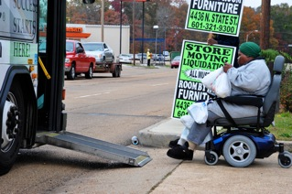
PROGRAM DESCRIPTIONS
5310 Enhanced Mobility of Seniors and Individuals with Disabilities
The goal of the Section 5310 program is to enhance mobility for seniors & persons with disabilities by providing funds for programs to serve the special needs of transit-dependent populations beyond traditional public transportation services & Americans with Disabilities Act complimentary para-transit services

Slide 61
PROGRAM DESCRIPTION-CONTD
5311 Rural Areas Programs
To provide capital, planning, and operating assistance to states to support public transportation including Job Access and Reverse Commute in rural areas with population less than 50,000, where many residents often rely on public transit to reach their destinations.

Slide 62
Benefits of Public Transit
Building and maintaining transportation infrastructure in urban and rural areas is imperative to meeting the need for access to jobs, shopping, government services, housing, education, and healthcare within small cities, towns, and their surrounding communities.
Provide better mobility for individuals and targeted groups (e.g. low income, seniors, persons with disabilities or veterans)
Generate jobs, enhance economic growth and support the implementation of public policies relating to areas such as health care, criminal justice recidivism as well as job development and training
Access and mobility are important to developing more vibrant and livable communities across the State.
With the increased emphasis on workforce development efforts (especially job development, training) transit projects have made much success in partnering with employers for trips to employment destination within the state.

Slide 63
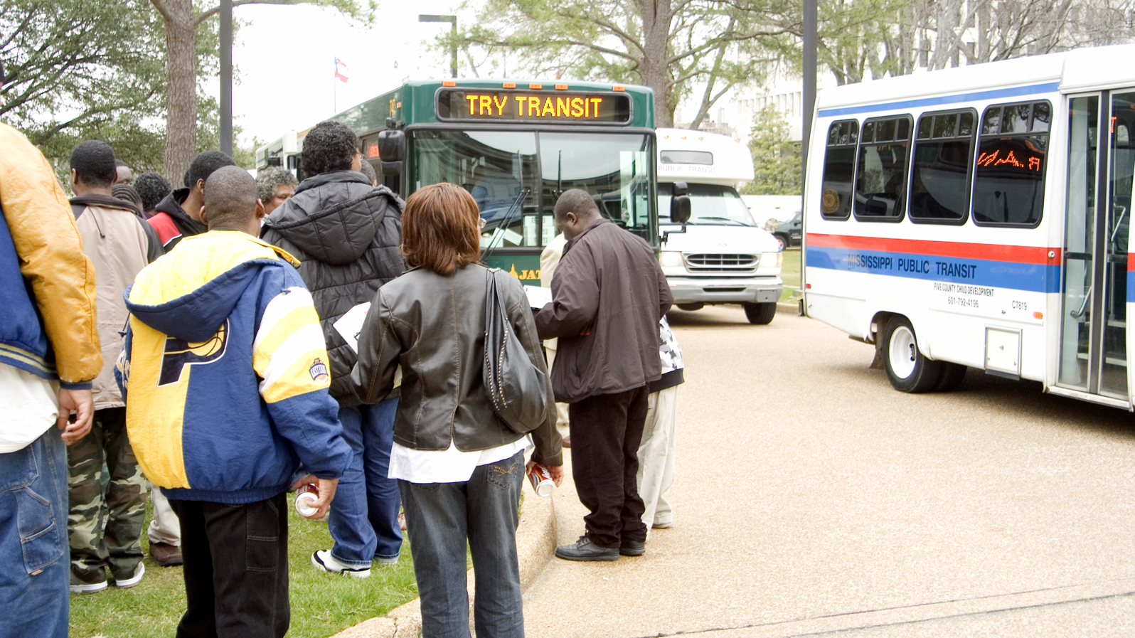
MS TRANSIT PROVIDERS
Total Number of Transit Providers - 67
Programs No of Providers
FTA 5310 42
FTA 5311 23
5311 (F)* 2
* Intercity Bus Operators

Slide 64
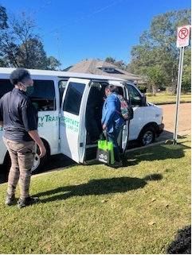
Project Partnership Spotlight Mount Zion Economic Community Center, Inc.
Mount Zion (dba Community Transit (CT)is a non-profit organization that begin transportation services in 2008.
Service Type: Flexible/Demand Response
Service Destinations: employment, education, medical, social services, recreation, grocery shopping etc. Also, non-emergency transportation for medical appointments, and medical prescriptions picked up (Medicaid)
Services Areas: Amite, Franklin, Lincoln, Pike and Wilkerson Counties
Number of vehicles: 20 buses/vans, 12 ADA accessible
Hours of Operation: Monday-Friday, 6:00 am-6:00 p.m. On call Sunday, Saturday.

Slide 65
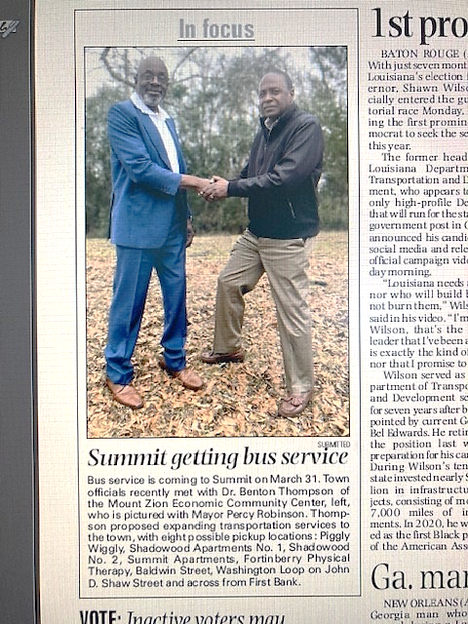
Partnership and Service
New service announcement in the Enterprise Newspaper for Summit, MS
Flexible-service routes for affordable housing complexes:
Shadowood Apartment 1 & 2
Summit Apartments

Slide 66
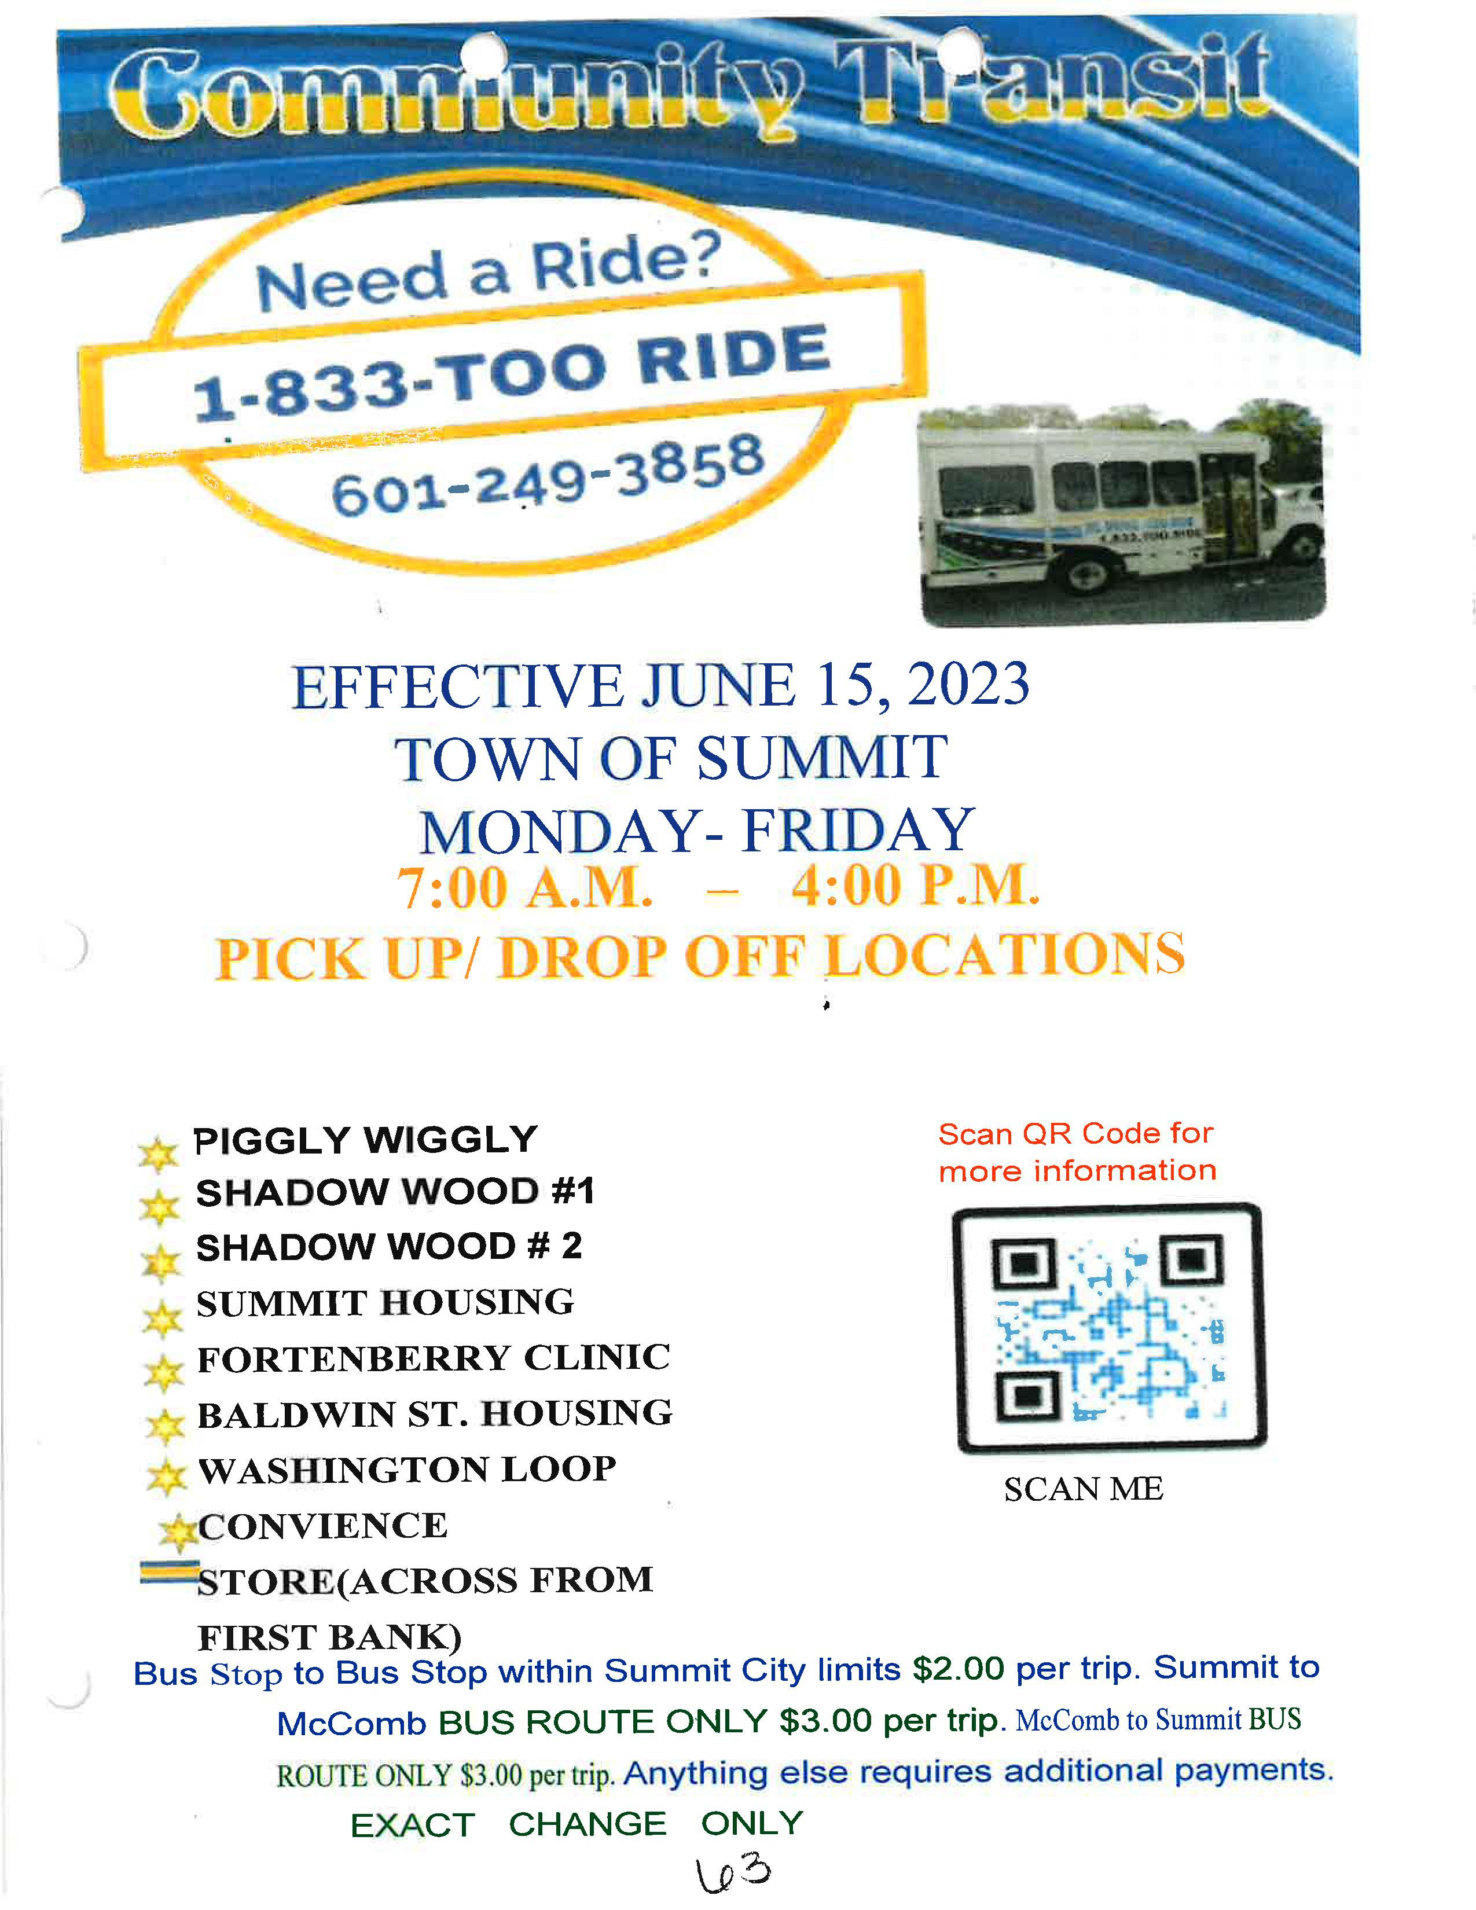
Transportation on the Move
Community Transit Stop at a Housing Complex in Summit, MS

Slide 67
How to Connect to Mobility Options – Regional Mobility Managers?
Delta Rides – Doris Green, Calvin Glover
662-846-6161
EZTAG – Jessica Martinez
601-650-7429/601-504-0415
NITA - Tonya Rhea Murphree
662-816-5209/662-234-3540
SMART – Lovie Martin/Michele Johnson
601-445-7568/601-402-5082/601-437-3063
Southern Connect – Donna Bailey, Kevin Hollingsworth
601-682-0701/601-788-2599
TRANSCON – Machelle Kyles, Atesa McKinney
60-960-0719/601-218-7674/601-665-2966

Slide 68
Test Your Knowledge

Slide 69
After conducting a market study, Sunset Properties decided that it will be best to develop their HOME-ARP affordable housing units in Meridian. Additional research indicates that there are limited or no access to public transportation in the area.
What agency and resources can Sunset Properties connect with to address transportation in their housing plan?
MDoT Transit Services, HOME-ARP transpiration

Slide 70
For additional Information
MDOT
MS Department of Transportation
P.O. Box 1850
Jackson, MS 39215-1850
601-359-7800
Shirley Wilson, Public Transit Director
e-mail: swilson@mdot.ms.gov
Dr. Charles R. Husband – Program Specialist Team Leader
e-mail: chusband@mdot.ms.gov
MHC
Tamara Stewart, VP Federal Grants
e-mail: tamara.stewart@mshc.com

